Slide 2

Maxymiser Campaign Acceptance Document
Test 51 – Reduce Fields on Passenger
Details Page
Inna Chorna
Technical Analyst
12th July, 2016

Slide 3
Change Log
Date | Description
Notes:
This is a sample Table slide, ideal for comparing data by year, product, revenues, etc. To Edit this Table, follow the steps below (this applies to all slides in this template that contain tables):
To Change Text in Table: Select text in table. Begin typing desired text. To move from one cell to another, press Tab.
To Change Font Color/Size: Select text, right-click and adjust the font setting on the Mini toolbar. Select desired attributes to change: font, size, boldness, color, etc. Note: many of the same commands can also be accessed from the Font group of the Home tab.
To Insert or Delete Rows in Table: To delete a row place cursor in a cell of the row, right-click for a pop up menu, select Delete Row. To Insert a row, place cursor in the row you want to place a row before, right-click for a pop up menu, select Insert and make a selection from the submenu. You can also use the Insert and Delete Rows and Columns tools on the Table Tools Layout tab to perform these actions.
To Insert or Delete Columns in Table: To delete a column, place cursor above the column (you will see a solid downward pointing arrow) click to select the column, right-click on the selected column, chose Delete Column from the pop up menu. To insert a column, place cursor above the column you wish to insert the new column before (you will see a solid downward pointing arrow) click to select the column, right-click for a pop up menu, select Insert and make a selection from the submenu. You can also use the Insert and Delete Rows and Columns tools on the Table Tools Layout tab to perform these actions.
To Highlight a Cell, Column or Row (for emphasis): Click to select an individual cell or click and drag through the desired column(s) or row(s). From the Table Tools Design tab, select the Shading button and select a desired fill color. (Note: It is best to use white text over dark backgrounds and black or dark gray text over light backgrounds.) While a table is selected, other formatting options are available on the Table Tools Design and Layout tabs.

Slide 4
General Campaign Setup Reduce Fields on Passenger Details Page

Slide 5
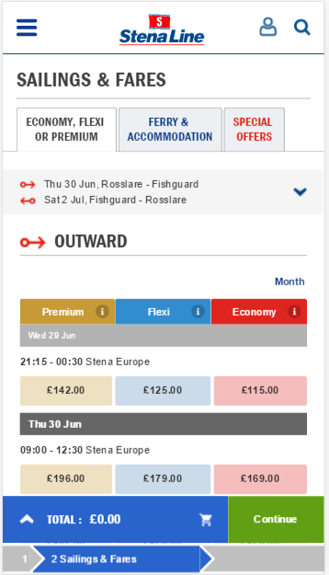
Campaign Background and Objective
Campaign Background
Stenaline would like to reduce number of field needed for Passenger details section. In order to make form shorter and therefore decrease time for filling the form
Campaign Objective
By reducing the number of fields, we would like to improve visitor experience within the booking funnel and therefore increase clickthrough to the next step and booking conversion.
As Stena Line
I want to make checkout process faster and easier for users
So that I can increase the number of bookings made by visitors and increase clickthrough.
Notes:
To Replace the Picture on this Sample Slide (this applies to all slides in this template that contain replaceable pictures)
Click the icon inside the shape to open the Insert Picture dialog box. Navigate to the location where the picture is stored, select desired picture and click on the Insert button to fit the image proportionally within the shape.

Slide 6
Browser Rules
This campaign will be deployed to the following devices:
☒ Desktop
☒ Tablet
☑ Mobile
The following is a customized list of browsers to be INCLUDED in the campaign:
DESKTOP DEPLOYMENT
EXCLUDED
Browser |  | Operating System
Type | Version | Type
Chrome | Any | Any
Edge | Any | Any
IE | 11 | Any
Firefox | 30+ | Any
Safari | 8+ | Any
TABLET DEPLOYMENT
EXCLUDED
Browser |  | Operating System
Type | Version | Type
Chrome | Any | Android
Safari | 8+ | iOS
MOBILE DEPLOYMENT
INCLUDED
Browser |  | Operating System
Type | Version | Type
Chrome | Any | Android
Safari | 8+ | iPhone OS

Slide 7
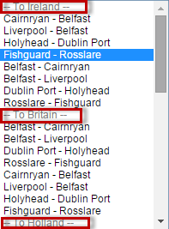
Generation Rules
User Story:
As Stena Line
I want to generate all visitors who select UK routes and land of the Passenger Details page into the test
So that I can analyse how their behaviour changes with our variants.
Acceptance Criteria | Given | When | Then
1 | That the visitor is on the Stena Line UK site (www.stenaline.co.uk) | They land on the Passenger Details page | They generate into the test.
2 | They have selected British routes only (i.e. routes from the ‘To Ireland’/’To Britain’/’To Holland’ sections) | They land on the Passenger Details page | They generate into the test.
Notes:
This is a sample Table slide, ideal for comparing data by year, product, revenues, etc. To Edit this Table, follow the steps below (this applies to all slides in this template that contain tables):
To Change Text in Table: Select text in table. Begin typing desired text. To move from one cell to another, press Tab.
To Change Font Color/Size: Select text, right-click and adjust the font setting on the Mini toolbar. Select desired attributes to change: font, size, boldness, color, etc. Note: many of the same commands can also be accessed from the Font group of the Home tab.
To Insert or Delete Rows in Table: To delete a row place cursor in a cell of the row, right-click for a pop up menu, select Delete Row. To Insert a row, place cursor in the row you want to place a row before, right-click for a pop up menu, select Insert and make a selection from the submenu. You can also use the Insert and Delete Rows and Columns tools on the Table Tools Layout tab to perform these actions.
To Insert or Delete Columns in Table: To delete a column, place cursor above the column (you will see a solid downward pointing arrow) click to select the column, right-click on the selected column, chose Delete Column from the pop up menu. To insert a column, place cursor above the column you wish to insert the new column before (you will see a solid downward pointing arrow) click to select the column, right-click for a pop up menu, select Insert and make a selection from the submenu. You can also use the Insert and Delete Rows and Columns tools on the Table Tools Layout tab to perform these actions.
To Highlight a Cell, Column or Row (for emphasis): Click to select an individual cell or click and drag through the desired column(s) or row(s). From the Table Tools Design tab, select the Shading button and select a desired fill color. (Note: It is best to use white text over dark backgrounds and black or dark gray text over light backgrounds.) While a table is selected, other formatting options are available on the Table Tools Design and Layout tabs.

Slide 8
Element and Variant Detail

Slide 9
Campaign Matrix
Element | Variant 1 | Variant 2
Fields | A1_Default | A2_Reduced
This will be an ABn test with 2 experiences.
Notes:
To Replace the Pictures on this Sample Slide (this applies to all slides in this template that contain replaceable pictures)
Click the icon inside the shape to open the Insert Picture dialog box. Navigate to the location where the picture is stored, select desired picture and click on the Insert button to fit the image proportionally within the shape.

Slide 10
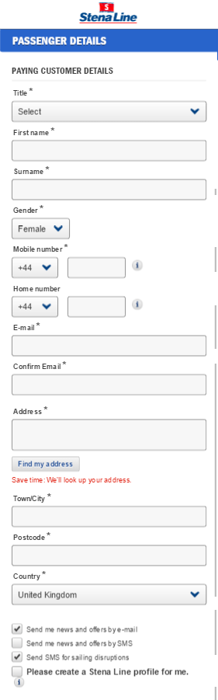
Campaign Variant – A1_Default
User Story:
As Stena Line
I want to check users behaviour within default layout
So that I can compare it with users behavior within alternative variants.
AC | Given | When | Then
1 | That the visitor generates in variant A1 | They land on the Passenger Details page | User should see default progress bar

Slide 11
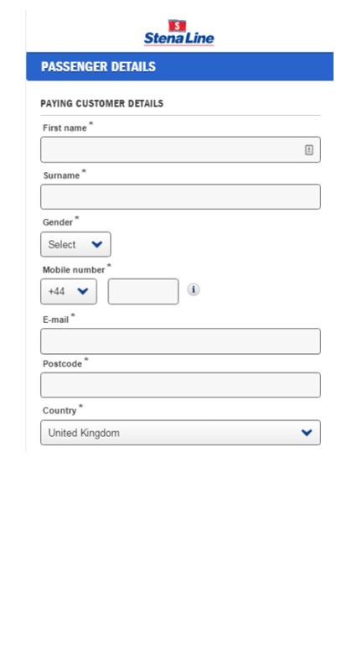
Campaign Variant – A2_Reduced
User Story:
As Stena Line
I want to reduce number of field on the Passengers Details page
So that I can determine its effect on visitors successfully click through.
AC | Given | When | Then
1. Hidden fields | That the visitor generates in variant A2 | They land on the Passenger Details page | Visitor should not see the following fields: - Title - Home number Confirm Email Address and “Find my address” CTA Town/City
2. Title | Visitor lands on the Passenger details page | Visitor clicks does not see ‘title” field and selects gender | The title field is hidden and will be populated based on gender (Male = Mr & Female = Ms)
3. Confirm Email | Visitor lands on the Passenger details page | Visitor enters the ‘email’ | The filed “confirm Email” is hidden and populate with value from ‘Email” filed
4. Address, Town/City | Visitor lands on the Passenger details page | Visitor does not see fields “Address”, “Town/City” | Each field is populated with value ‘N/A’

Slide 12
Metrics

Slide 13
Metrics Overview
Metric | Description | Value | Attributes
PaymentDetails | Visitor clicks through to the Payment Details page
Booking | User completes a booking | Revenue (GBP)
Error | Visitor clicks on continue CTA and sees an error |  | CustomerDetails PassVehicleDetails TCLinks
ErrorsCustDet | User generates an error on Paying Customer Details section
CustDetails | User completes Customer Details section on the page
PassVehDetails | User completes the Passenger and Vehicles section on the page

Slide 14
Payment
User Story:
As Stena Line
I want to track users who click through to the Payment Details page
So that I can assess the impact our variants have on clickthrough.
Acceptance Criteria | Given | When | Then
1. Acceptance Criteria | That a user generates into the test | They land on the Payment Details page | Payment tracks.

Slide 15
Booking
User Story:
As Stena Line
I want to track bookings made during the test
So that I can assess the impact of the variants on bookings.
Acceptance Criteria | Given | When | Then
1. Acceptance Criteria | that a user generates into the test | they load the booking confirmation page | Booking tracks
 |  |  | And track value = revenue in GBP

Slide 16
Error
User Story:
As Stena Line
I want to track users who generate an error
So that I can assess the impact our variants have on visitors completing this section.
Acceptance Criteria | Given | When | Then
1. Acceptance Criteria | That a user generates into the test | Visitor clicks on continue CTA and sees an error | Error tracks with an attribute CustomerDetails PassVehicleDetails TCLinks

Slide 17
ErrorsCustDet
User Story:
As Stena Line
I want to track users who generate an error in the Paying Customer Details section of the form
So that I can assess the impact our variants have on visitors completing this section.
Acceptance Criteria | Given | When | Then
1. Acceptance Criteria | That a user generates into the test | They generate an error in the Paying Customer Details section of the form | ErrorsCustDet tracks.

Slide 18
CustDetails
User Story:
As Stena Line
I want to track users who complete the Paying Customer Details section of the form
So that I can assess the impact our variants have on visitors completing this section.
Acceptance Criteria | Given | When | Then
1. Acceptance Criteria | That a user generates into the test | There are no errors in the Paying Customer Details section fields (i.e. with all fields successfully validated), and user proceeds to the next section | CustDetails tracks.

Slide 19
PassVehDetails
User Story:
As Stena Line
I want to track users who complete the Passengers & Vehicles section of the form
So that I can assess the impact our variants have on visitors completing this section.
Acceptance Criteria | Given | When | Then
1. Acceptance Criteria | That a user generates into the test | There are no errors in the Passengers & Vehicles section fields (i.e. with all fields successfully validated), and user proceeds to the next section | PassVehDetails tracks.

Slide 20
Additional Information

Slide 21
Integration Details
User Story: Google Analytics
As Stena Line
I want to track the behavior of visitors who have generated into the campaign in Google Analytics
So that I can use Google Analytics reports to measure the impact of the variant on visitor behaviour.
Acceptance Criteria | Given | When | Then
1 | That a visitor generates into the test | they reach the test page | the integration is fired and it uses custom variable 3.

Slide 22
Integration Details
User Story: SessionCam
As Stena Line
I want to track the behavior of visitors who have generated into the campaign in SessionCam
So that I can use SessionCam reports to measure the impact of the variant on visitor behaviour.
Acceptance Criteria | Given | When | Then
1 | that a visitor generates into the test | they reach the test page | the integration is fired.

Slide 23
QA Report

Slide 24
Testing Strategy
Agile approach |  |  | Full coverage
Tested according to delivery plan |  |  | Tested in every browser with equal effort
User Story name | Time per User Story, hrs |  | User Story name | Time per User Story, hrs
campaign generation | 1 |  | campaign generation | 1.5
Default | 1 |  | Default | 1.5
A2_Reduced | 4 |  | A2_Reduced | 6
PaymentDetails | 1 |  | PaymentDetails | 1.5
Booking | 1 |  | Booking | 1.5
Error | 1 |  | Error | 1.5
ErrorCustDet | 1 |  | ErrorCustDet | 1.5
CustDetails | 1 |  | CustDetails | 1.5
PassVehDetails | 1 |  | PassVehDetails | 1.5
Google Analytics | 1 |  | Google Analytics | 1.5
SessionCam | 1 |  | SessionCam | 1.5
UI settings, Risks | 1.3 |  | UI settings, Risks | 1.8
Bug fixing | 2.6 |  | Bug fixing | 3.6
Total hours for QA | 17 |  | Total hours for QA | 23

Slide 25
Test Report
 |  | Phones
 |  | Safari 9 | Safari 8 | Chrome Android
Story type | Story name
Generation | campaign generation | S | S | T
Variants | Default | S | S | T
Variants | A2_Reduced | T | S | S
Actions | PaymentDetails | S | S | T
Actions | Booking | S | S | T
Actions | Error | S | S | T
Actions | ErrorCustDet | S | S | T
Actions | CustDetails | S | S | T
Actions | PassVehDetails | S | S | T
Third Party Integration | Google Analytics | S | S | T
Third Party Integration | SessionCam | S | S | T

Slide 26
Publish Instruction
What needs to be published:
Campaign | Site Objects
Campaign: Actions: | Site Objects: Site Browser Rules General Site Settings

Slide 27
Inna Chorna
Technical Analyst

